Slide 1
Presented by Thaison Nguyen
Largo Medical Office Building
Architectural Engineering Structural Option Structural Committee| Faculty Advisor
Notes:
Notes:

Slide 2
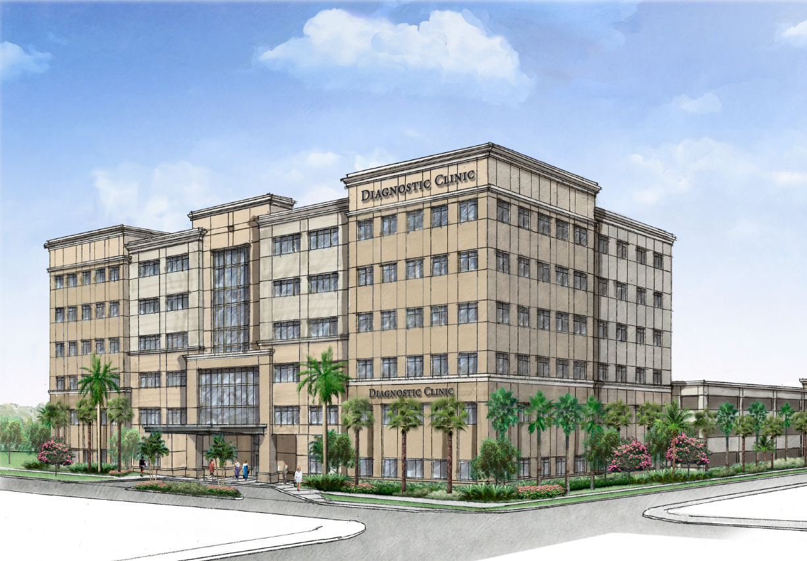
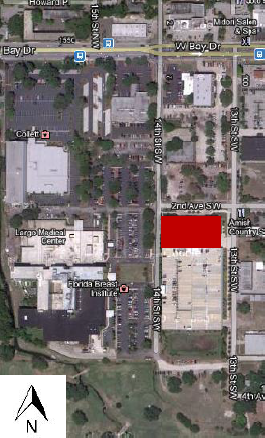
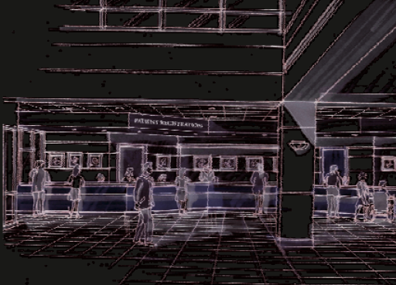
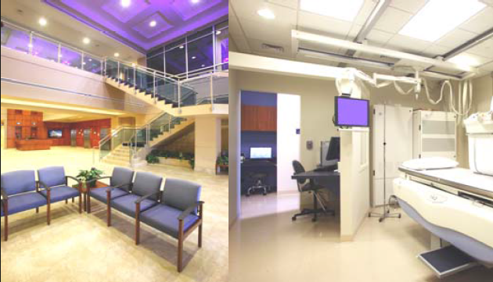
General
Gross Area: 154,240 sq. ft.
As-Built Cost: $12.6 Million (not including equipment)
Dates of Construction: August 2008 — November 2009
Project Delivery Method: Design-Bid-Build
MEP Systems
Primary Cooling: DX with (2) Cooling Towers
Heating: Resistant Heating Elements located at each floor
Electrical: 480/277V 3 phase - High Voltage
208/120V 3 phase - Low Voltage
Lighting: LED and Fluorescent Lighting with occupancy and photo-sensors
Source: Oliver, Glidden, Spina & Associates
Source: Oliver, Glidden, Spina & Associates
Source: Oliver, Glidden, Spina & Associates
Building Overview Scope and Intent Solving Torsional Irregularity Construction Management Lessons Learned
Notes:
Notes:

Slide 3
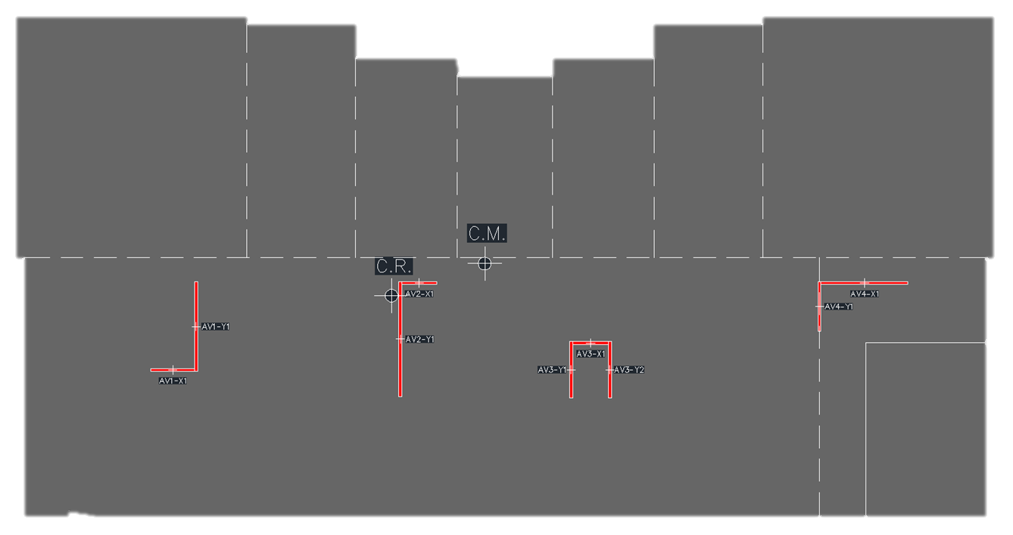
Project Intent
Tame torsional and soft-story effects
Project Scope
Evaluate redesigns of LMOB’s lateral system
Façade redesign
Table P1.1, Design Guides
Use | Codes and Standards
General Building Code | IBC 2009
General Load Determination | ASCE 7-05
Structural Steel Design | AISC Steel Design and Construction Manual 14th Edition
Steel Reinforcement Parameters | ASTM A615
Reinforced Concrete Design | ACI 318-11
Tilt-Up Wall Design | TCA Tilt-Up Construction and Design Manual 2006
Cold Formed Steel (CFS) Design | AISI Manual 2008
Other | ACI 201.2R-08
 | ASHRAE Standard 170
Building Overview Scope and Intent Solving Torsional Irregularity Construction Management Lessons Learned
Notes:
Notes:

Slide 4
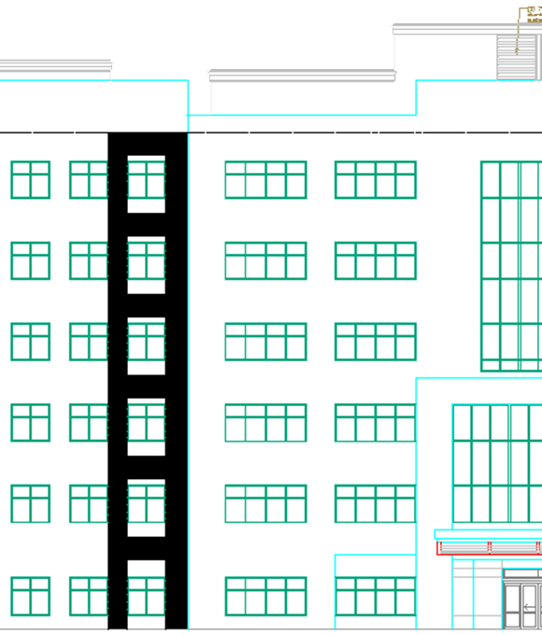
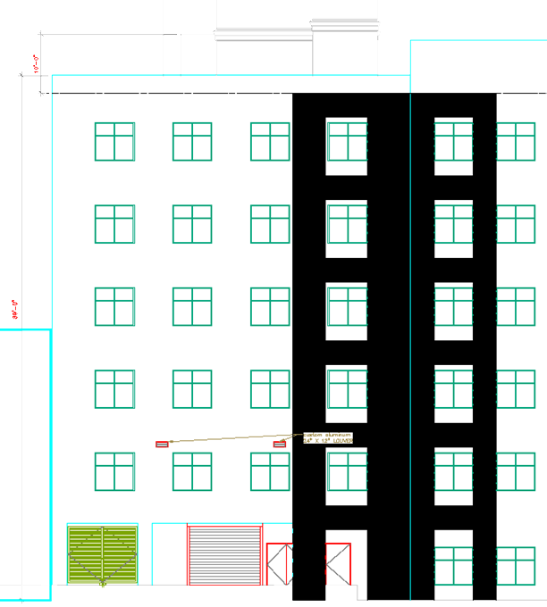
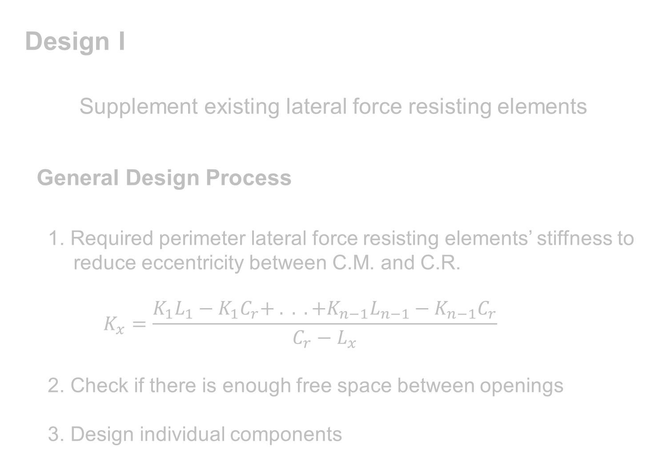
Design I
Supplement existing lateral force resisting elements
General Design Process
1. Required perimeter lateral force resisting elements’ stiffness to reduce eccentricity between C.M. and C.R.
$$K_{x}=\frac{K_{1}L_{1}−K_{1}C_{r}+ . . . +K_{n−1}L_{n−1}−K_{n−1}C_{r}}{C_{r}−L_{x}}$$
2. Check if there is enough free space between openings
3. Design individual components
East Façade
North Façade
Building Overview Scope and Intent Solving Torsional Irregularity Construction Management Lessons Learned
Notes:
Notes:

Slide 5
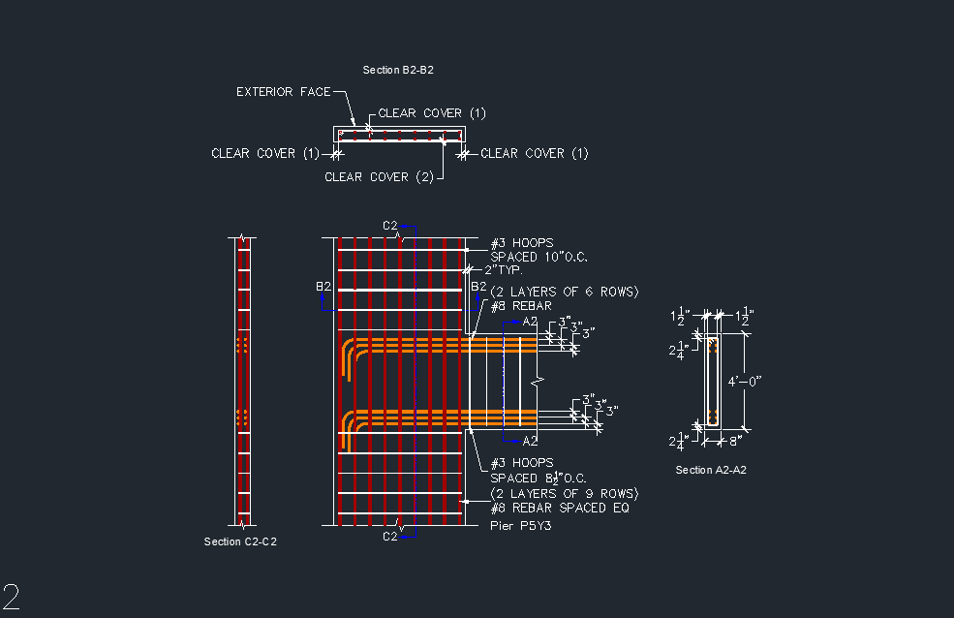
Table P1.2, Comparison of Center of Mass and Center of Rigidity Outputs
Story | ETABS |  |  |  | Hand Calculations
 | X_{CM} | Y_{CM} | X_{CR} | Y_{CR} | X_{CM} | Y_{CM} | X_{CR} | Y_{CR}
STORY6 | 114.75 | 58.44 | 120.61 | 64.29 | 114.79 | 58.90 | 117.18 | 63.61
STORY5 | 114.79 | 58.9 | 121.34 | 64.13 | 114.69 | 58.72
STORY4 | 114.79 | 58.9 | 121.78 | 63.52 | 114.69 | 58.72
STORY3 | 114.79 | 58.9 | 121.71 | 62.23 | 114.69 | 58.72
STORY2 | 114.79 | 58.9 | 118.51 | 59.14 | 114.69 | 58.72
STORY1 | 114.69 | 58.72 | 112.77 | 54.76 | 110.07 | 59.34
Table P1.3, Base Shear of Lateral Force Resisting Elements
Element | V_{base} (Kip)
 | Original | Design I
AV1-X1 | 76.5 | 62
AV1-Y1 | 325 | 229.1
AV2-Y1 | 304.4 | 335.4
AV2-X1 | 63.9 | 43.7
AV3-Y1 | 126.6 | 102
AV3-X1 | 121.7 | 33.4
AV3-Y2 | 121.7 | 102
AV4-Y1 | 84 | 89.5
AV4-X1 | 159.6 | 187.4
AV5-X1 | N/A | 14.8
AV5-Y1 | N/A | 145.9
AV5-Y2 | N/A | 23.8
Building Overview Scope and Intent Solving Torsional Irregularity Construction Management Lessons Learned
Notes:
Notes:

Slide 6
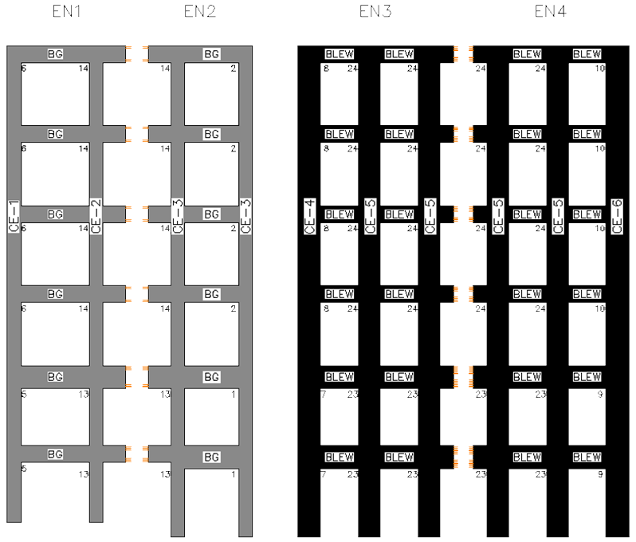
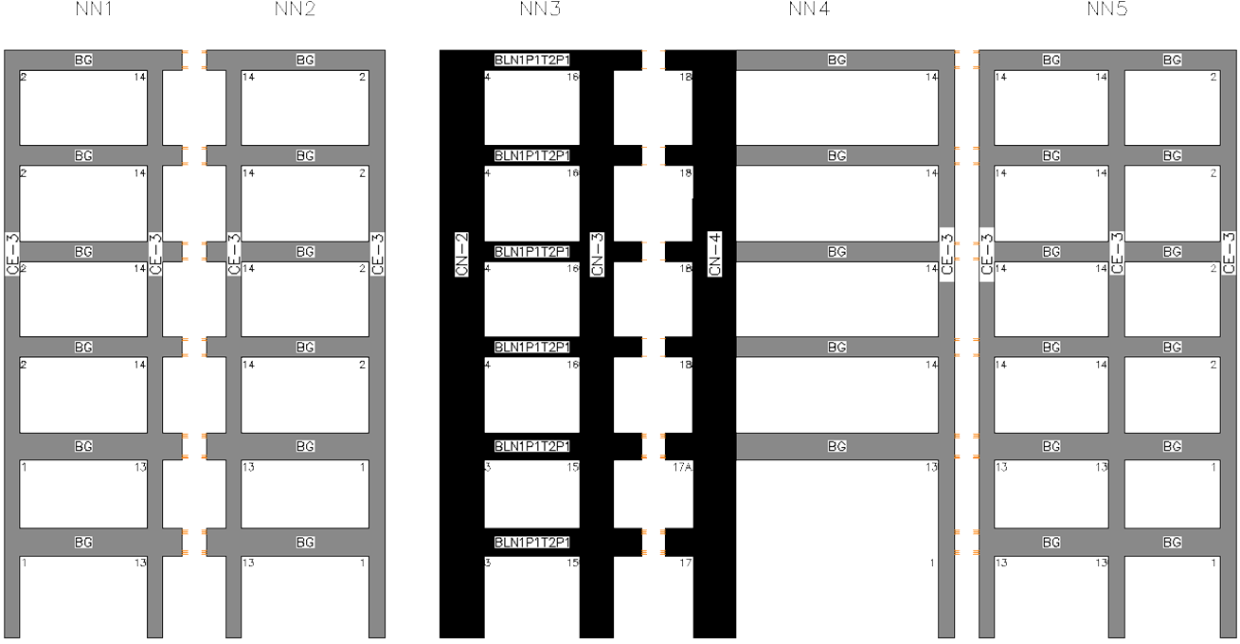
Design II
Move lateral force resisting elements to the perimeter
General Design Process
1. Based on building symmetry and openings in façade, select locations for lateral force resisting elements
2. Determine stiffness of preliminary lateral force resisting elements
3. Access torsional effects
4. Design individual components
East Façade Tilt-Up Wall Panels
North Façade Tilt-Up Wall Panels
Building Overview Scope and Intent Solving Torsional Irregularity Construction Management Lessons Learned
Notes:
Notes:

Slide 7
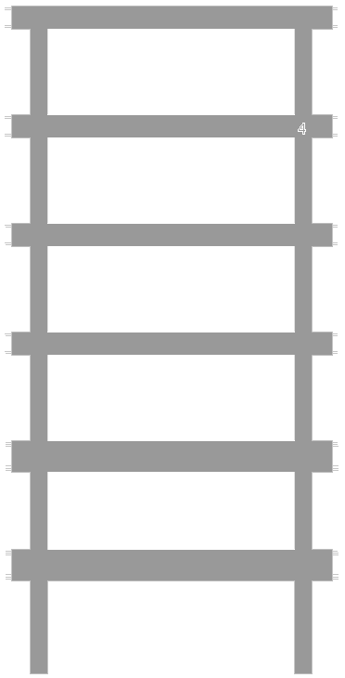
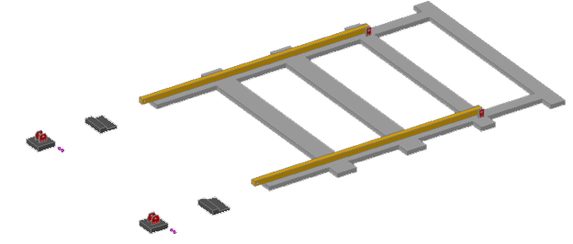
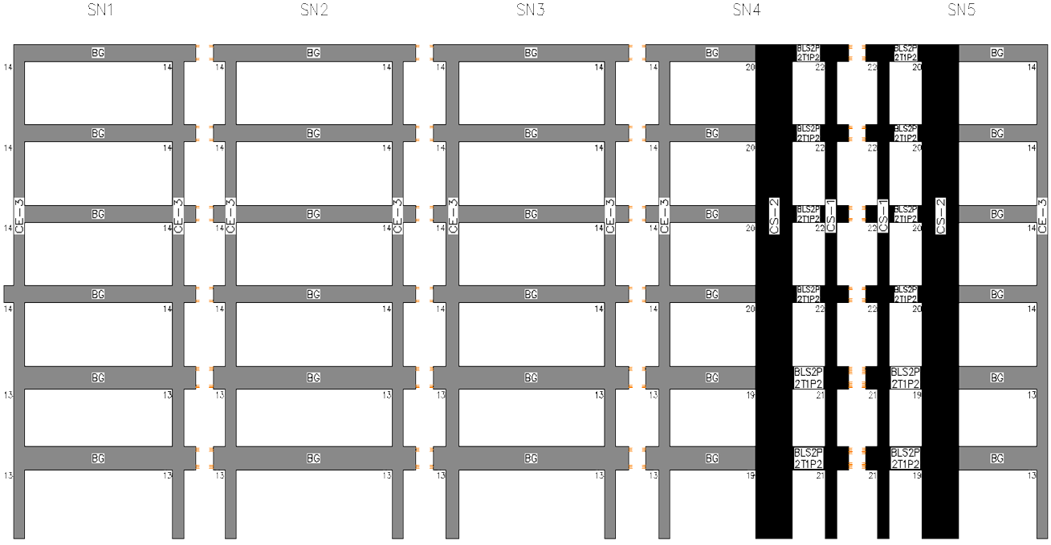
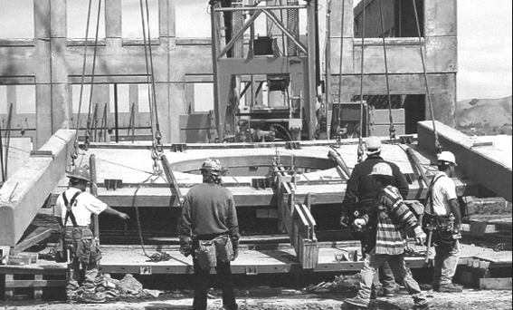
Table P1.4, Maximum Factored Loads on Structural Tilt-Up Walls
Loading Condition | Maximum Loads
 | Moment (Kip-ft) | Shear (Kip)
Two Level Brace Points | 84.2 | 12.9
Wind MWFRS (Constr.) | 40.5 | 4.8
Wind MWFRS | 15.6 | 5.9
Table P1.5, Slenderness Magnification Factor and Loads Incorporating Factor
Panel Angle (°) | δ | M_{u,pΔ-max} (kip-ft) |  | P_{u,pΔ-max} (kip) |  | V_{u,pΔ-max} (kip)
 |  | 1.2D + 1.6W | 1.4D | 1.2D + 1.6W | 1.4D | 1.2D + 1.6W | 1.4D
0 | 1.00 |  | 83.5 |  |  |  | 12.9
10 | 1.05 |  | 84.2 |  | 0.0 |  | 12.7
20 | 1.10 |  | 80.4 |  | 3.8 |  | 12.2
30 | 1.15 |  | 74.3 |  | 0.0 |  | 0.0
40 | 1.21 |  | 65.7 |  | 7.1 |  | 0.0
50 | 1.26 |  | 55.1 |  | 0.0 |  | 0.0
60 | 1.30 |  | 42.8 |  | 0.0 |  | 0.0
90 | 1.37 | 44.4 |  | 9.5 | 11.0 | 4.9
South Façade Tilt-Up Wall Panels
Source: TCA, 2006
Building Overview Scope and Intent Solving Torsional Irregularity Construction Management Lessons Learned
Notes:
Notes:

Slide 8
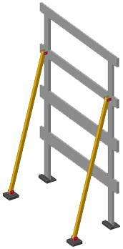
Table P1.6, Initial Design Parameters
Factored Axial Load (Kip) | L (in) | I_{req} (in⁴)
29.8 | 894 | 105.5
97.9 | 547 | 129.5
235.3 | 547 | 311.2
Table P1.7, Magnification Factors
Member | H (Kip) | Δ_{H} (in) | P_{e} (Kip) | P_{r}/P_{y} | EI* | P_{e1} (Kip) | B₂ | B₁
HSS10x10x3/8 | 2.14 | 0.000 |  | 0.049 | 4686400 | 57.8 | 0 | 2.1
HSS10x10x3/8 | 1.31 | 0.000 |  | 0.161 | 4686400 | 154.8 | 0 | 2.7
HSS12x12x1/2 | 2.08 | 0.000 |  | 0.245 | 10602400 | 350.2 | 0 | 3.0
Table P1.8, Temporary Bracing Combined Loading
Bracing Member | P_{r} (Kip) | M_{r} (Kip-ft) | P_{r}/P_{c} | P_{r}/P_{c} + 8/9(M_{r}/M_{c})
HSS10x10x3/8 | 29.8 | 82.4 | 0.52 | 0.97
HSS10x10x3/8 | 97.9 | 40.6 | 0.64 | 0.86
HSS12x12x1/2 | 235.3 | 72.2 | 0.68 | 0.89
Building Overview Scope and Intent Solving Torsional Irregularity Construction Management Lessons Learned
Notes:
Notes:

Slide 9
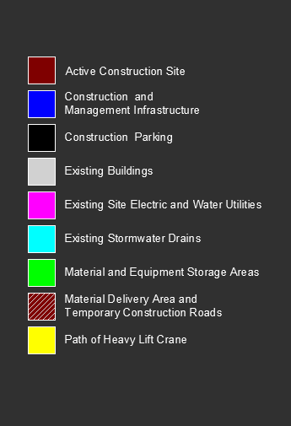
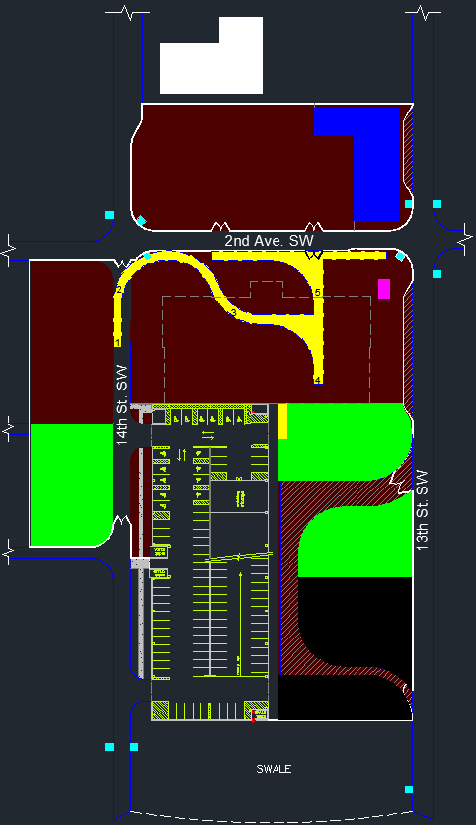
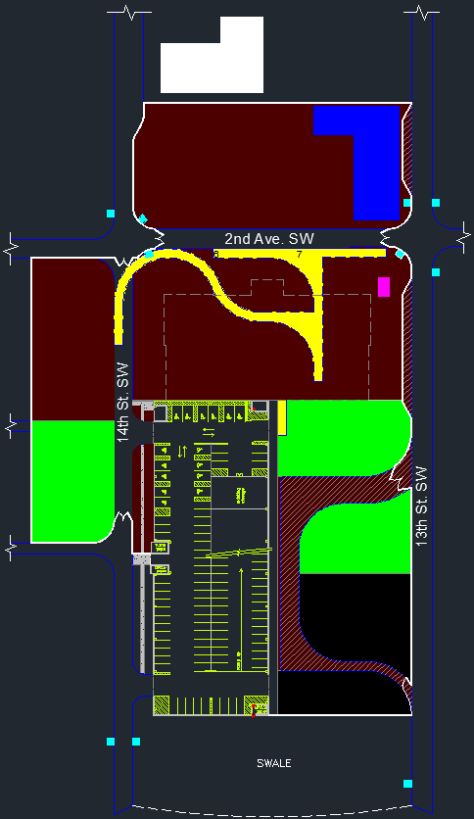
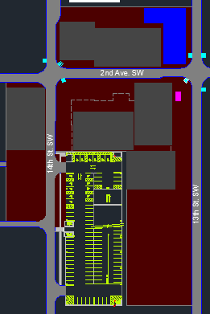

Position 3
Position 5
Position 6
Position 7
Position 2
Position 4
Position 1
Building Overview Scope and Intent Solving Torsional Irregularity Construction Management Lessons Learned
Notes:
Notes:

Slide 10
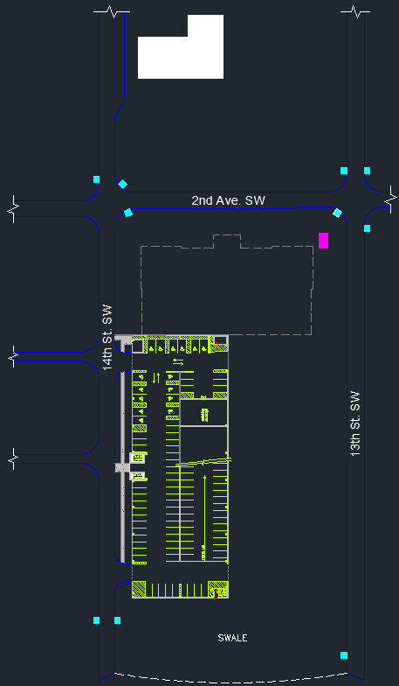
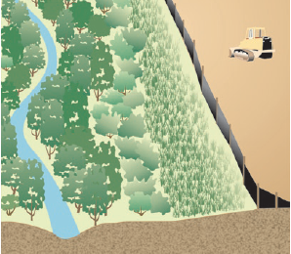
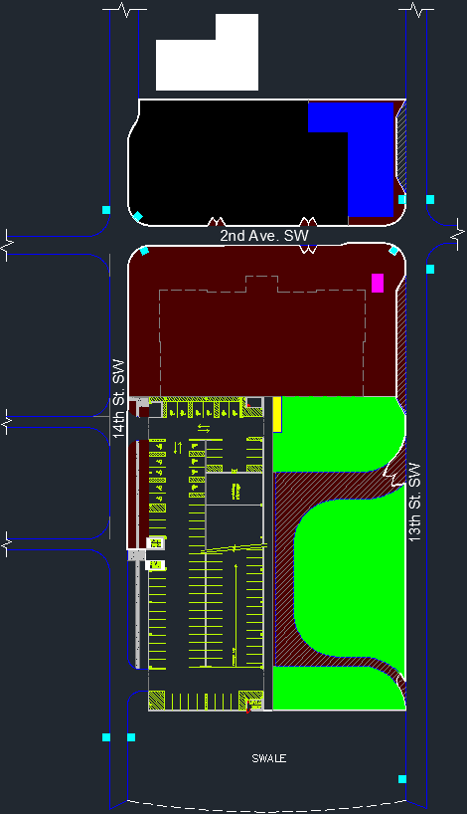
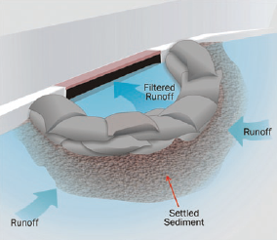
Construction Logistics
1. No weather related or safety violations that will cause delays
2. Reduce impact on surrounding facilities
3. Prevent contaminants from leaving site
4. Keep track of all equipment and materials on the site
5. Maximum equipment and material dimensions are bounded
Source: EPA Stormwater Management Guide
Source: EPA Stormwater Management Guide
Building Overview Scope and Intent Solving Torsional Irregularity Construction Management Lessons Learned
Notes:
Notes:

Slide 11
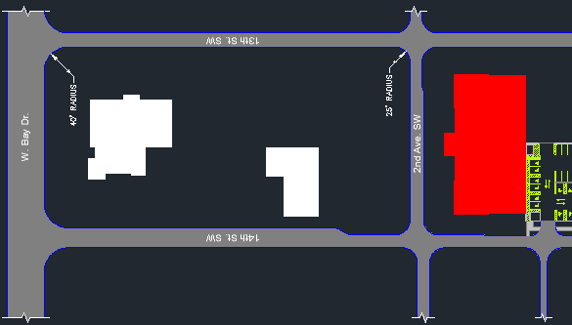
Table P1.9, Cargo Capacity and Turning Radius of Various Truck Types Source: Texas Department of Transportation Roadway Design Manual
Truck Type | Maximum Cargo Length | Turning Radius for 90° Turn
Single Unit – 20’-0” Wheelbase | 22’-0” | 42’-0”
Semi-Truck – 23’-6” Wheelbase | 30’-0” | 40’-0”
Semi-Truck – 31’-4” Wheelbase | 37’-4” | 45’-0”
Semi-Truck – 42’-0” Wheelbase | 42’-0” | 45’-0”
Table P1.10, Total and Select Itemized Cost of Each Design
Design | Itemized Cost |  |  | Total Cost
 | Necessary Infrastructure | Structural | Façade
Original | $293,658 | $3,710,785 | $869,748 | $12,600,000
Design I | $307,176 | $3,776,745 | $858,413 | $12,668,143
Design II | $576,009 | $3,546,273 | $1,799,585 | $13,647,676
Building Overview Scope and Intent Solving Torsional Irregularity Construction Management Lessons Learned
Notes:
Notes:

Slide 12
Table P1.11, Displacement at Roof Corners
Story | Corner | Load | Design I |  | Design II
 |  |  | X | Y | X | Y
6 | NW | WINDDX | 0.69 | -0.15 | 0.56 | 0
 | NW | WINDDY | -0.24 | 0.82 | 0.01 | 0.84
 | NW | WINDT1DX | 0.49 | -0.17 | 0.41 | -0.03
 | NW | WINDT1DY | -0.33 | 0.28 | -0.06 | 0.5
 | NW | WINDT2 | 0.07 | -0.02 | 0.25 | 0.32
 | NW | WINDDXY | 0.33 | 0.51 | 0.43 | 0.63
 | NW | WINDT1DNX | 0.54 | -0.04 | 0.44 | 0.02
 | NW | WINDT1DNY | -0.03 | 0.95 | 0.07 | 0.75
 | NE | WINDDX | 0.69 | -0.08 | 0.56 | 0
 | NE | WINDDY | -0.24 | 0.62 | 0.01 | 0.81
 | NE | WINDT1DX | 0.49 | 0 | 0.41 | 0.02
 | NE | WINDT1DY | -0.33 | 0.77 | -0.06 | 0.73
 | NE | WINDT2 | 0.07 | 0.67 | 0.25 | 0.6
 | NE | WINDDXY | 0.33 | 0.4 | 0.43 | 0.61
 | NE | WINDT1DNX | 0.54 | -0.12 | 0.44 | -0.02
 | NE | WINDT1DNY | -0.03 | 0.16 | 0.07 | 0.49
Table P1.12, Total and Select Itemized Cost of Each Design
Design | Itemized Cost |  |  | Total Cost
 | Necessary Infrastructure | Structural | Façade
Original | $293,658 | $3,710,785 | $869,748 | $12,600,000
Design I | $307,176 | $3,776,745 | $858,413 | $12,668,143
Design II | $576,009 | $3,546,273 | $1,799,585 | $13,647,676
Table P1.13, Estimated Acoustical Performance of Wall
Wall Type | STC
Façade Wall Redesign | 54
Original and Retrofit Wall Design | 57
Table P1.14, Condensation Drying Rate for 3/8” Weep Hole
Head Height |  | Max Wall Area Served |  | Exit Flow Rate ((2ρgh/m)^{1/2}) |  | Drainage Time (s)
in | mm | m² | ft² | m/s | ft/s
0.1875 | 4.7625 | 64 | 689 | 1.2 | 4.0 | 0.02
Original = 0.72, Design I = 0.62, Design II = 0.65
Building Overview Scope and Intent Solving Torsional Irregularity Construction Management Lessons Learned
Notes:
Notes:

Slide 13
Carry on the struggle
Notes:
Notes:

Slide 14
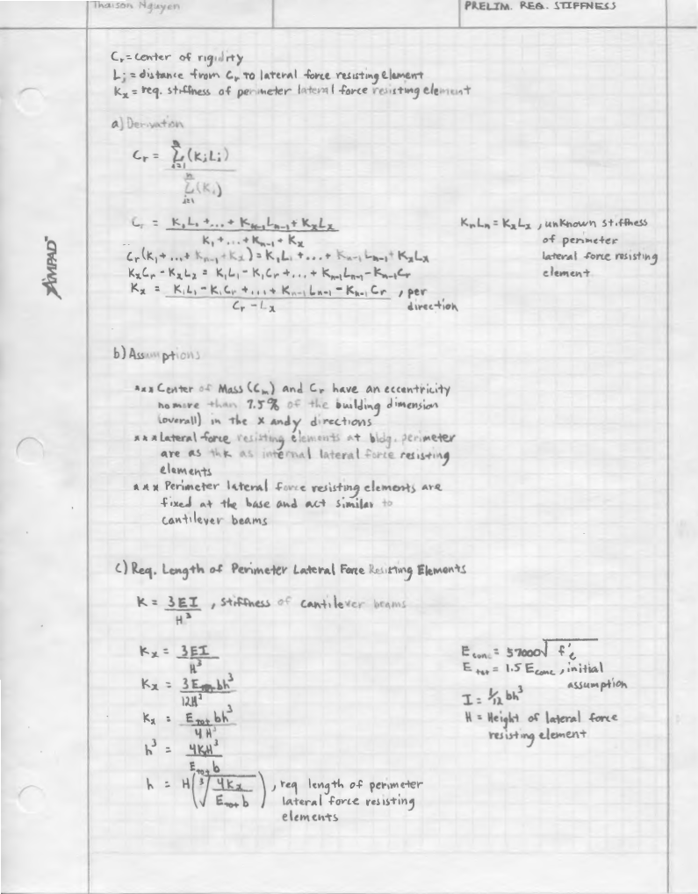
Appendix
Table AP1.1, Calculated Design I Center of Rigidity
Lateral Resisting Element |  | Stiffness | Element C.R. |  | Global C.R.
Designation | Resisting Direction |  | x (ft) | y (ft) | x (ft) | y (ft)
AV1-X1 | X | 15.18 | 36.84 | 34.33 | 117.18 | 63.61
AV1-Y1 | Y | 122.10 | 42.34 | 44.54
AV2-Y1 | Y | 248.14 | 90.26 | 41.59
AV2-X1 | X | 7.53 | 94.68 | 54.76
AV3-Y1 | Y | 31.20 | 130.34 | 34.42
AV3-X1 | X | 8.23 | 134.88 | 40.67
AV3-Y2 | Y | 31.20 | 139.42 | 34.42
AV4-Y1 | Y | 21.79 | 188.63 | 49.26
AV4-X1 | X | 112.61 | 199.17 | 54.76
AV5-Y1 | Y | 31.716 | 229.17
AV5-Y2 | Y | 91.324 | 226.83
AV5-X1 | X | 31.726 |  | 117.08
Table AP1.3, Formatted ETABS Center of Mass and Center of Rigidity Output for Design I
Story | XCM (ft) | YCM (ft) | XCR (ft) | YCR (ft)
STORY6 | 114.75 | 58.44 | 120.61 | 64.29
STORY5 | 114.79 | 58.9 | 121.34 | 64.13
STORY4 | 114.79 | 58.9 | 121.78 | 63.52
STORY3 | 114.79 | 58.9 | 121.71 | 62.23
STORY2 | 114.79 | 58.9 | 118.51 | 59.14
STORY1 | 114.69 | 58.72 | 112.77 | 54.76
Table AP1.4, Formatted ETABS Center of Mass and Center of Rigidity Output for Design II
Story | XCM (ft) | YCM (ft) | XCR (ft) | YCR (ft)
STORY6 | 114.77 | 58.42 | 116.8 | 59.52
STORY5 | 114.83 | 58.89 | 117.01 | 59.08
STORY4 | 114.83 | 58.89 | 117.23 | 58.76
STORY3 | 114.83 | 58.89 | 117.4 | 58.6
STORY2 | 114.83 | 58.89 | 117.47 | 58.77
STORY1 | 114.74 | 58.71 | 116.62 | 59.1
Table AP1.2, Calculated Design II Center of Rigidity
Lateral Resisting Element |  | Stiffness | Element C.R. |  | Global C.R.
Designation | Resisting Direction
 |  |  | x (ft) | y (ft) | x (ft) | y (ft)
A1-Y1 | Y | 291.715 | 0.42 | 88.75 | 114.80 | 61.30
A2-Y1 | Y | 291.715 | 229.08 | 88.75
A5-X1 | X | 215.657 | 152.38 | 115.00
A6-X1 | X | 190.186 | 179.00 | 0.42
Building Overview Scope and Intent Solving Torsional Irregularity Construction Management Lessons Learned
Notes:
/*Stiffness derivation for prelim design – Hand*/

Slide 15
Table AP 1.5, Case I MWFRS Applied Loads
Floor Level | Wind Perpendicular to Long Side | Wind Perpendicular to Short Side
 | Kip | Kip
0 | 62.76 | 25.43
1 | 121.12 | 49.43
2 | 124.09 | 51.79
3 | 131.29 | 55.47
4 | 137.03 | 58.41
5 | 141.78 | 60.84
Roof 1 | 168.50 | 47.45
Top | 29.61 | 14.47
Table AP 1.7, Calculations: Wind Perpendicular to Long Side (Part 2)
Floor Level | Wind Load Torsion Component in Lateral Resisting Elements (Kip)
 | AV1-X1 | AV1-Y1 | AV2-Y1 | AV2-X1 | AV3-X1 | AV3-Y2 | AV4-Y1 | AV4-X1 | AV5-Y1 | AV5-Y2 | AV5-X1
0 | 0.046 | 1.57 | 3.18 | 0.0068 | 0.019 | 0.12 | 0.16 | 0.10 | 0.61 | 1.72 | 0.17
1 | 0.10 | 1.06 | 2.15 | 0.015 | 0.043 | 0.080 | 0.35 | 0.23 | 0.41 | 1.16 | 0.39
2 | 0.10 | 1.04 | 2.11 | 0.015 | 0.042 | 0.079 | 0.35 | 0.22 | 0.40 | 1.14 | 0.38
3 | 0.11 | 1.10 | 2.24 | 0.016 | 0.045 | 0.084 | 0.37 | 0.24 | 0.43 | 1.21 | 0.40
4 | 0.11 | 1.15 | 2.33 | 0.017 | 0.047 | 0.087 | 0.39 | 0.25 | 0.45 | 1.26 | 0.42
5 | 0.11 | 1.19 | 2.42 | 0.017 | 0.048 | 0.090 | 0.40 | 0.26 | 0.46 | 1.30 | 0.44
Roof 1 | 0.14 | 1.41 | 2.87 | 0.020 | 0.058 | 0.11 | 0.47 | 0.30 | 0.55 | 1.55 | 0.52
Top | 0.024 | 0.25 | 0.50 | 0.0036 | 0.010 | 0.02 | 0.083 | 0.053 | 0.10 | 0.27 | 0.091
Table AP 1.9, Calculations: Wind Perpendicular to Long Side (Part 4)
 | AV1-X1 | AV1-Y1 | AV2-Y1 | AV2-X1 | AV3-X1 | AV3-Y2 | AV4-Y1 | AV4-X1 | AV5-Y1 | AV5-Y2 | AV5-X1
V_{base} (Kip) | 0.7 | 213.5 | 433.9 | 0.1 | 0.3 | 51.6 | 33.9 | 1.6 | 49.7 | 143.5 | 2.8
M_{ov,base} (Kip-ft) | 38.0 | 10945 | 22243 | 5.6 | 16.1 | 2665.3 | 1749.4 | 85.2 | 2585.9 | 7455.3 | 145.0
Table AP 1.6, Calculations: Wind Perpendicular to Long Side (Part 2)
Floor Level | Wind Load Direct Component in Lateral Resisting Elements (Kip)
 | AV1-X1 | AV1-Y1 | AV2-Y1 | AV2-X1 | AV3-X1 | AV3-Y2 | AV4-Y1 | AV4-X1 | AV5-Y1 | AV5-Y2 | AV5-X1
0 | 0.00 | 14.03 | 28.51 | 0.00 | 0.00 | 3.58 | 2.50 | 0.00 | 3.64 | 10.49 | 0.00
1 | 0.00 | 27.07 | 55.02 | 0.00 | 0.00 | 6.92 | 4.83 | 0.00 | 7.03 | 20.25 | 0.00
2 | 0.00 | 27.74 | 56.37 | 0.00 | 0.00 | 7.09 | 4.95 | 0.00 | 7.20 | 20.75 | 0.00
3 | 0.00 | 29.35 | 59.64 | 0.00 | 0.00 | 7.50 | 5.24 | 0.00 | 7.62 | 21.95 | 0.00
4 | 0.00 | 30.63 | 62.24 | 0.00 | 0.00 | 7.83 | 5.47 | 0.00 | 7.96 | 22.91 | 0.00
5 | 0.00 | 31.69 | 64.40 | 0.00 | 0.00 | 8.10 | 5.66 | 0.00 | 8.23 | 23.70 | 0.00
Roof 1 | 0.00 | 37.66 | 76.54 | 0.00 | 0.00 | 9.62 | 6.72 | 0.00 | 9.78 | 28.17 | 0.00
Top | 0.00 | 6.62 | 13.45 | 0.00 | 0.00 | 1.69 | 1.18 | 0.00 | 1.72 | 4.95 | 0.00
Table AP 1.8, Calculations: Wind Perpendicular to Long Side (Part 3)
Floor Level | Total Wind Load in Lateral Resisting Elements (Kip)
 | AV1-X1 | AV1-Y1 | AV2-Y1 | AV2-X1 | AV3-X1 | AV3-Y2 | AV4-Y1 | AV4-X1 | AV5-Y1 | AV5-Y2 | AV5-X1
0 | -0.046 | 15.59 | 31.69 | -0.0068 | -0.019 | 3.47 | 2.34 | -0.10 | 3.04 | 8.78 | 0.174
1 | -0.101 | 28.13 | 57.16 | -0.015 | -0.043 | 6.84 | 4.48 | -0.23 | 6.62 | 19.09 | 0.386
2 | -0.100 | 28.78 | 58.48 | -0.015 | -0.042 | 7.01 | 4.60 | -0.22 | 6.80 | 19.61 | 0.381
3 | -0.106 | 30.45 | 61.87 | -0.016 | -0.045 | 7.41 | 4.87 | -0.24 | 7.19 | 20.74 | 0.403
4 | -0.110 | 31.78 | 64.58 | -0.017 | -0.047 | 7.74 | 5.08 | -0.25 | 7.51 | 21.65 | 0.421
5 | -0.114 | 32.88 | 66.82 | -0.017 | -0.048 | 8.01 | 5.26 | -0.26 | 7.77 | 22.40 | 0.435
Roof 1 | -0.135 | 39.07 | 79.41 | -0.020 | -0.058 | 9.52 | 6.25 | -0.30 | 9.23 | 26.62 | 0.517
Top | -0.024 | 6.87 | 13.95 | -0.0036 | -0.010 | 1.67 | 1.10 | -0.053 | 1.62 | 4.68 | 0.091
Table AP 1.10, Comparison between Calculations and Computer Output
Computer Output for Base Shear Experienced by AV1-Y1 (Kip) | 209.30
Difference w/ Calculations (%) | 2.03 | < | 10.00 | √
Building Overview Scope and Intent Solving Torsional Irregularity Construction Management Lessons Learned

Slide 16
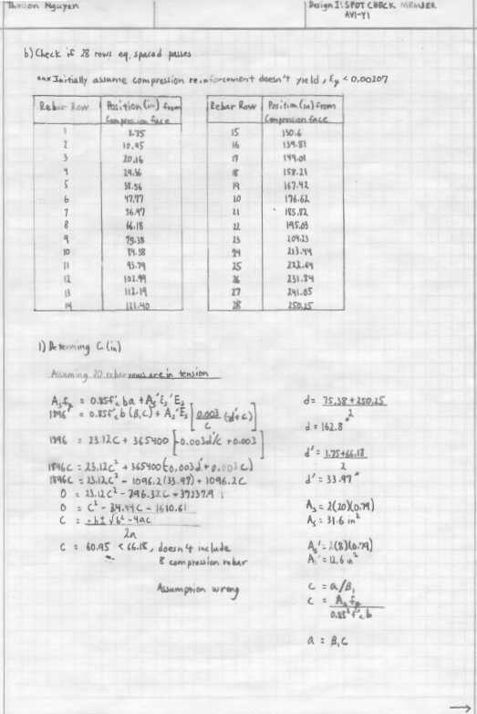
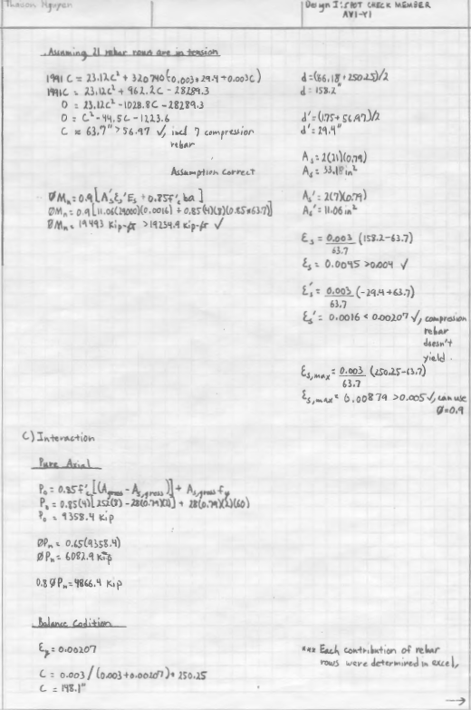
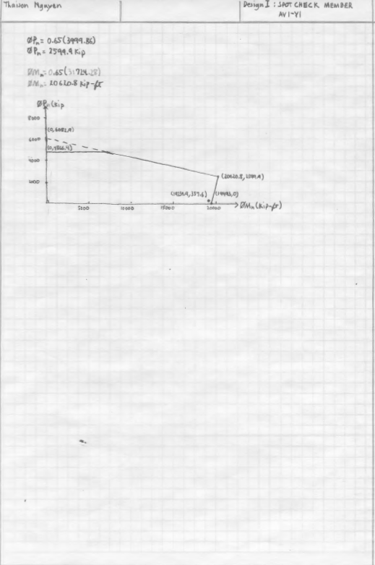
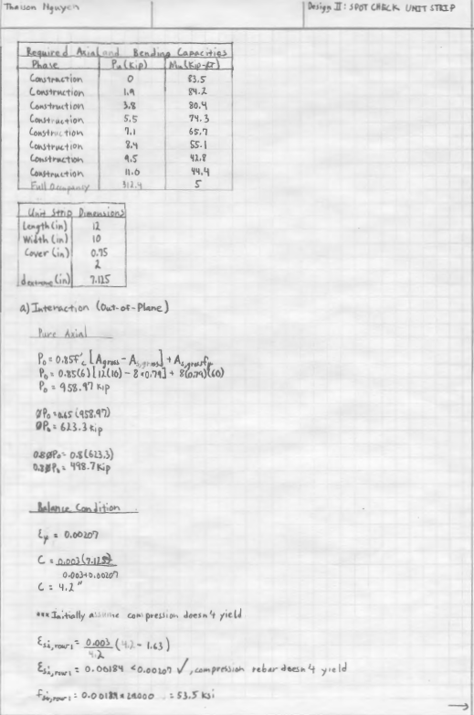
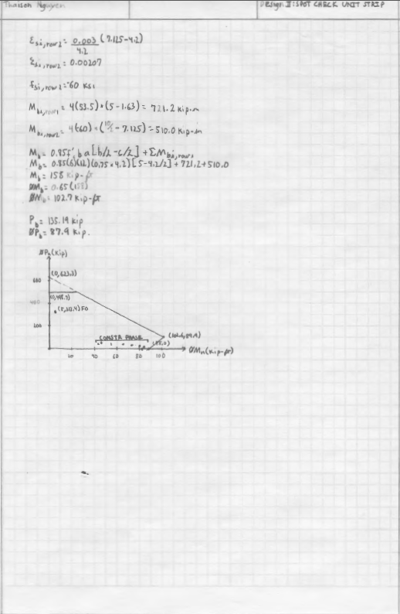
Table AP 1.11. Reinforcement Contribution to Axial and Bending Capacity
Row | Position (in) | ε_{si} | f_{si} (Ksi) | M_{bi} (Kip-in) | M_{b} (Kip-ft) | P_{b} (Kip)
1 | 1.75 | 0.00296 | 60 | 14910.0 | 31724.28 | 3999.86
2 | 10.95 | 0.00278 | 60 | 13805.6
3 | 20.16 | 0.00259 | 60 | 12701.1
4 | 29.36 | 0.00241 | 60 | 11596.7
5 | 38.56 | 0.00222 | 60 | 10492.2
6 | 47.77 | 0.00203 | 58.94 | 9222.0
7 | 56.97 | 0.00185 | 53.53 | 7390.6
8 | 66.18 | 0.00166 | 48.13 | 5758.4
9 | 75.38 | 0.00147 | 42.72 | 4325.1
10 | 84.58 | 0.00129 | 37.31 | 3090.9
11 | 93.79 | 0.00110 | 31.91 | 2055.7
12 | 102.99 | 0.00091 | 26.50 | 1219.6
13 | 112.19 | 0.00073 | 21.10 | 582.5
14 | 121.40 | 0.00054 | 15.69 | 144.4
15 | 130.60 | 0.00035 | 10.28 | -94.6
16 | 139.81 | 0.00017 | 4.88 | -134.6
17 | 149.01 | -0.00002 | -0.53 | 24.4
18 | 158.21 | -0.00020 | -5.94 | 382.5
19 | 167.42 | -0.00039 | -11.34 | 939.6
20 | 176.62 | -0.00058 | -16.75 | 1695.7
21 | 185.82 | -0.00076 | -22.16 | 2650.9
22 | 195.03 | -0.00095 | -27.56 | 3805.1
23 | 204.23 | -0.00114 | -32.97 | 5158.3
24 | 213.44 | -0.00132 | -38.37 | 6710.6
25 | 222.64 | -0.00151 | -43.78 | 8461.9
26 | 231.84 | -0.00170 | -49.19 | 10412.2
27 | 241.05 | -0.00188 | -54.59 | 12561.6
28 | 250.25 | -0.00207 | -60 | 14910.0
Building Overview Scope and Intent Solving Torsional Irregularity Construction Management Lessons Learned
Notes:
/*Interaction Capacity Check*/

Slide 17
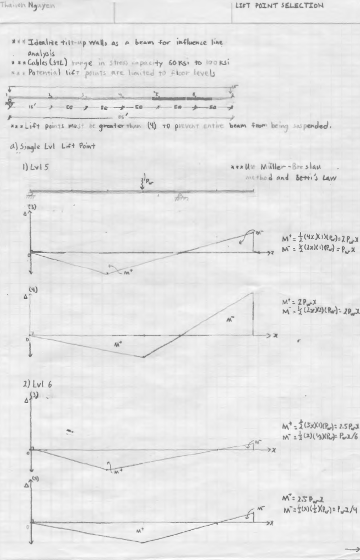
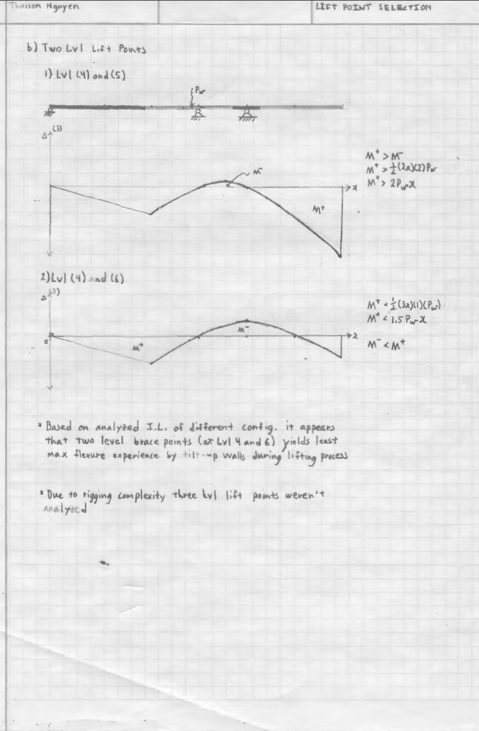
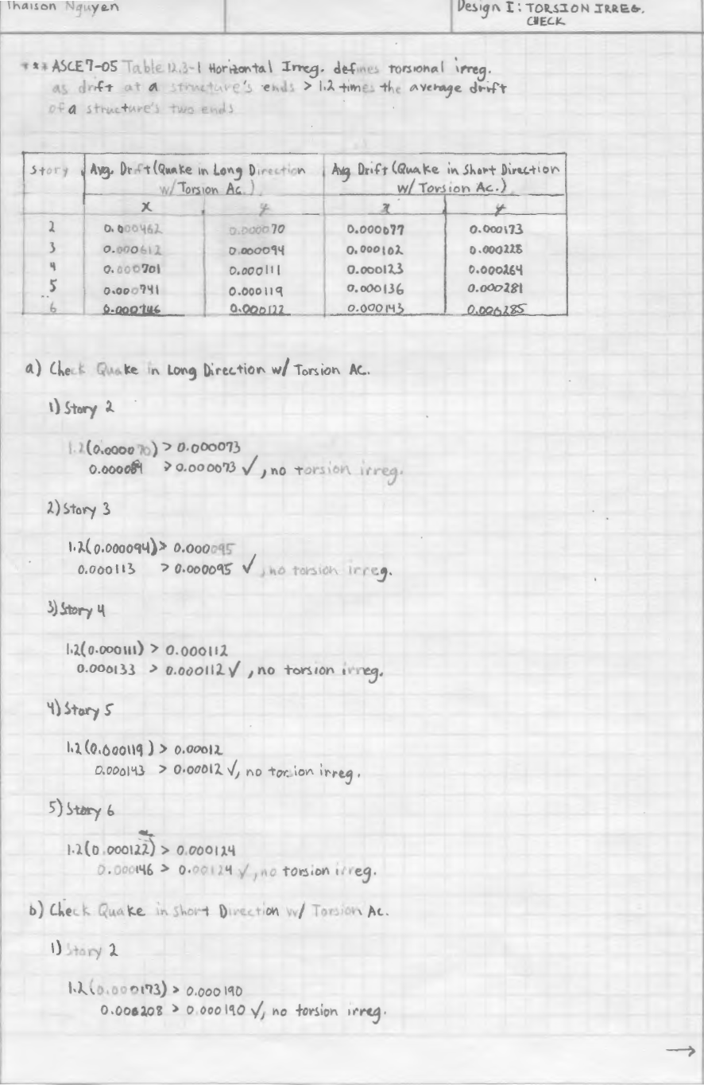
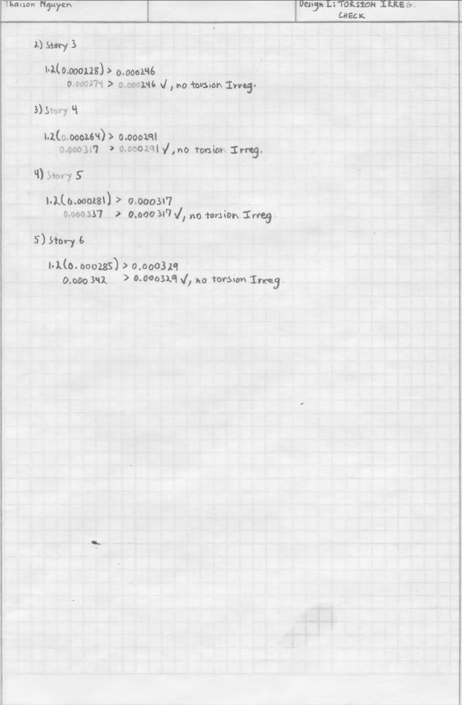
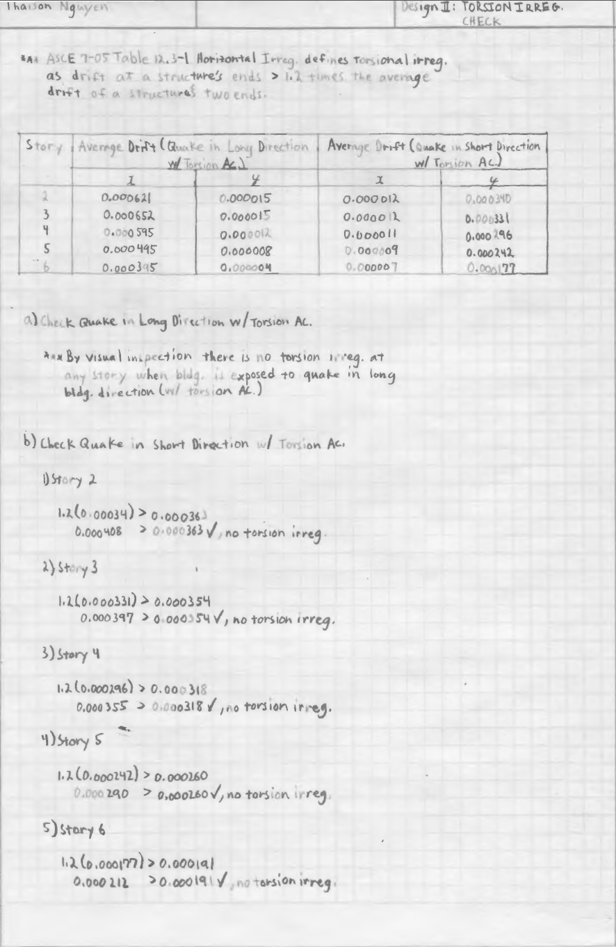
Gen. Modeling Assumptions
1. All concrete lateral force resisting elements act as if they’re are monolithically cast
2. Effective concrete cross-sections is 35% of gross cross-sectional area
3. Rigid panel zone factor 1.0
4. Considered P-Δ effects for drift analysis
5. Seismic importance factor is 1.25
6. All pin connections are perfectly frictionless
7. Non lateral force resisting elements carry no lateral load to the ground
8. Beam end offsets to the pier face
9. Floor diaphragms are considered rigid
10. MEP openings are ignored
11. All material weights are zero
12. Use ACI 318-08 and occasionally ACI 318-05 design criteria
Building Overview Scope and Intent Solving Torsional Irregularity Construction Management Lessons Learned
Notes:
/*Influence lines – Hand*/

Slide 18
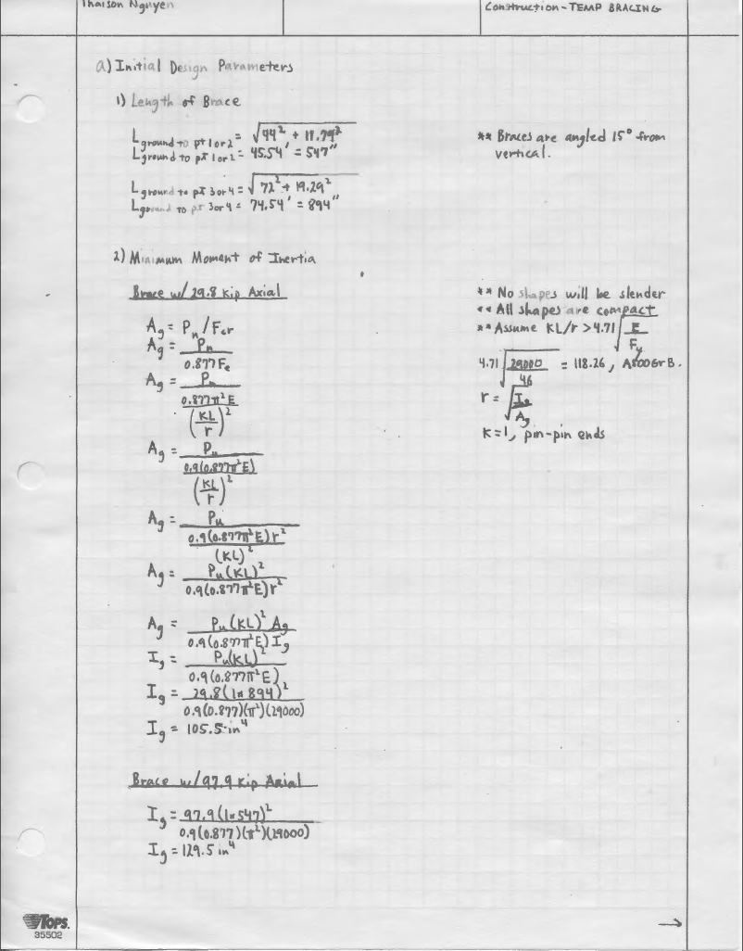
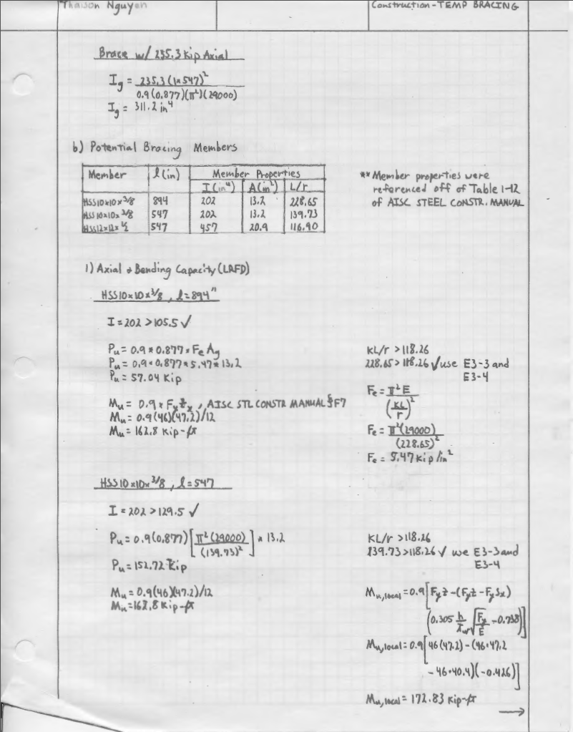
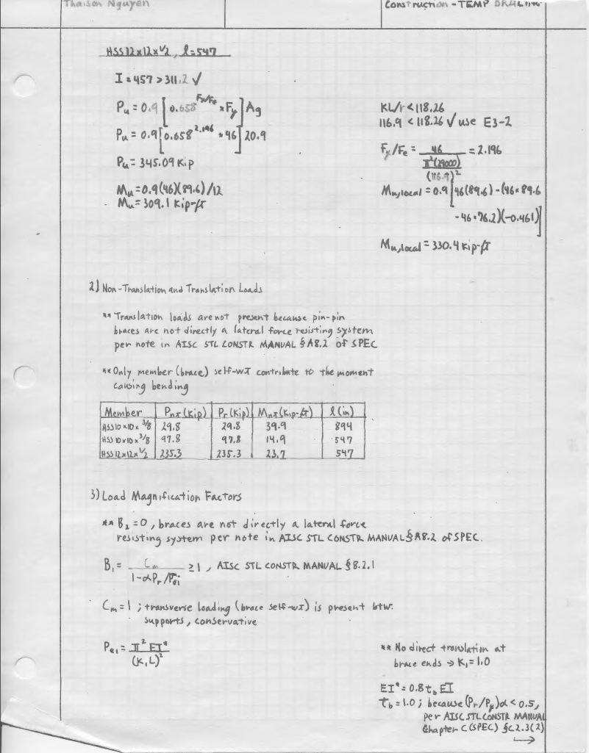
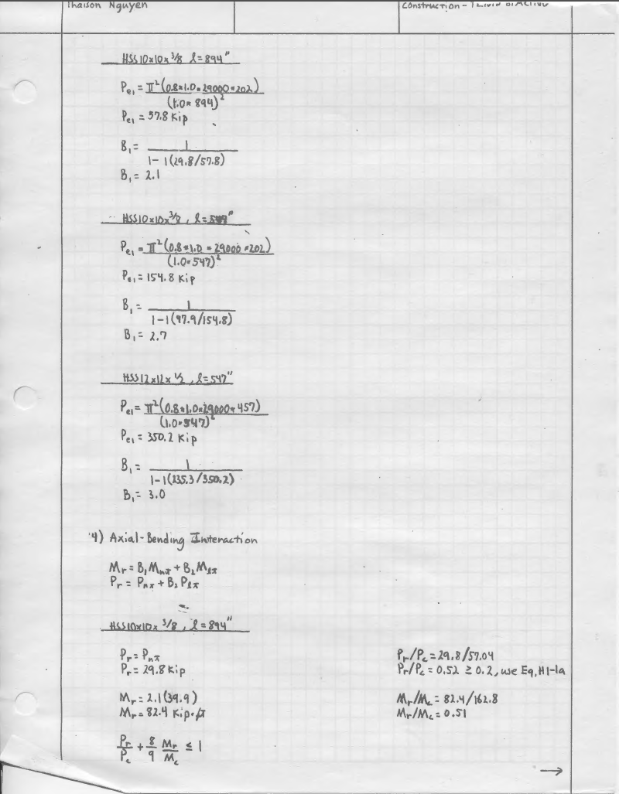
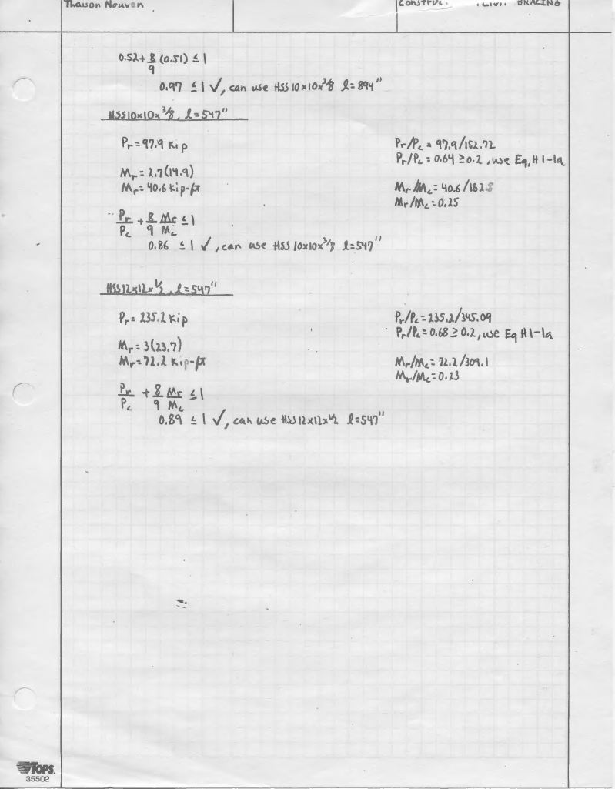
Building Overview Scope and Intent Solving Torsional Irregularity Construction Management Lessons Learned
Notes:
/*Temp Bracing*/

Slide 19
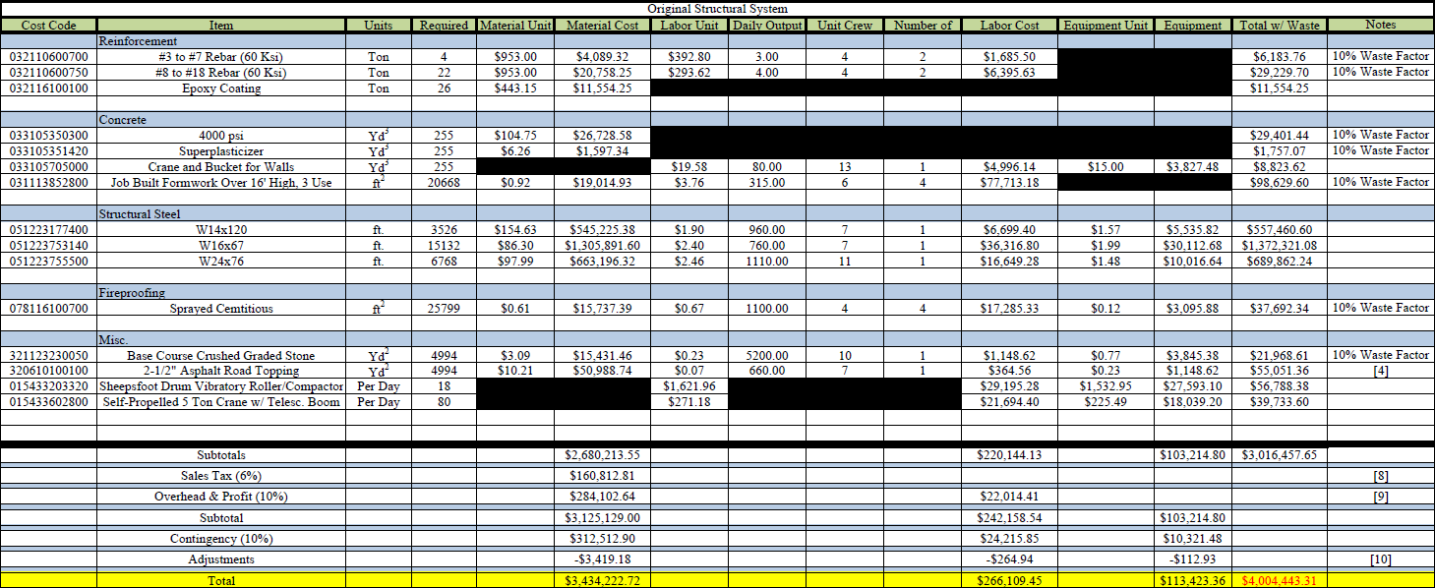
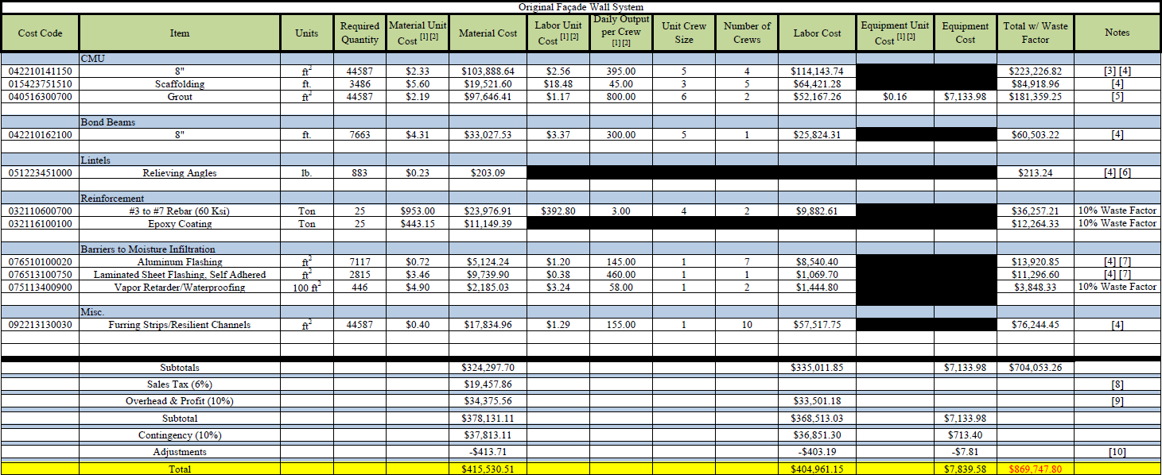
Building Overview Scope and Intent Solving Torsional Irregularity Construction Management Lessons Learned

Slide 20
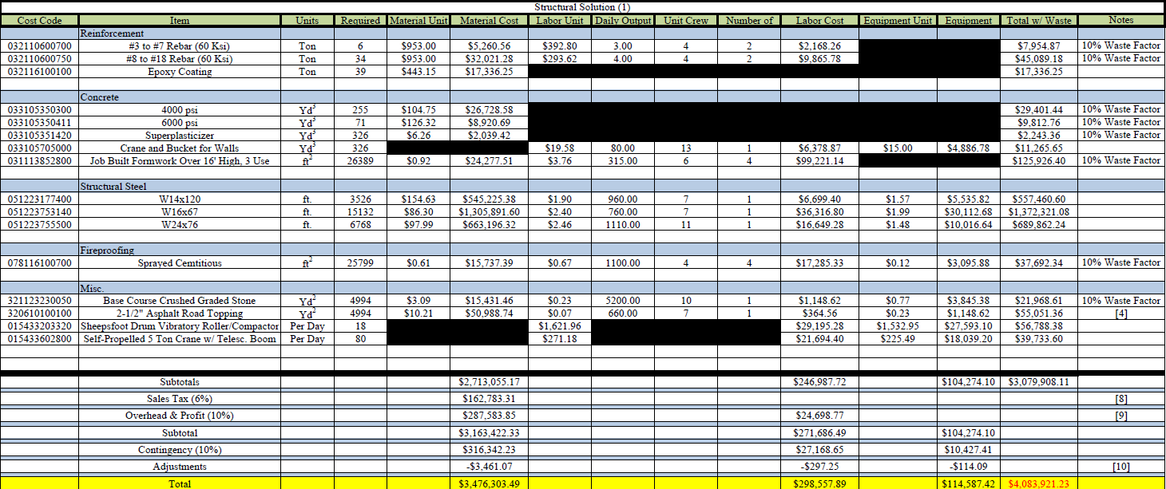
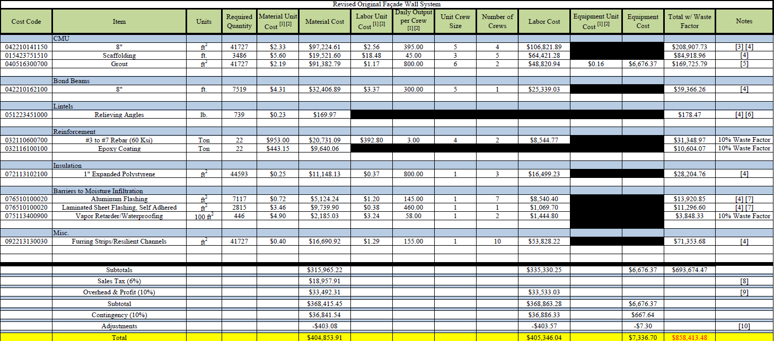
Building Overview Scope and Intent Solving Torsional Irregularity Construction Management Lessons Learned

Slide 21
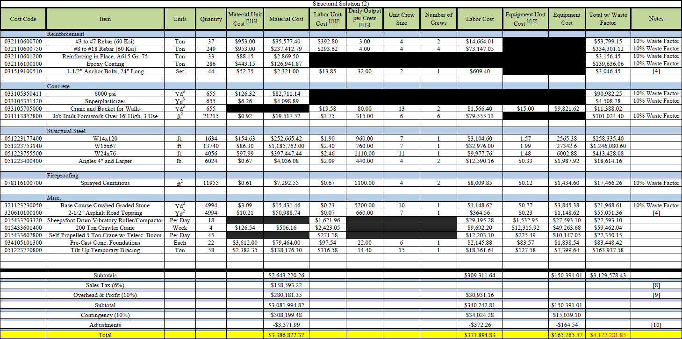
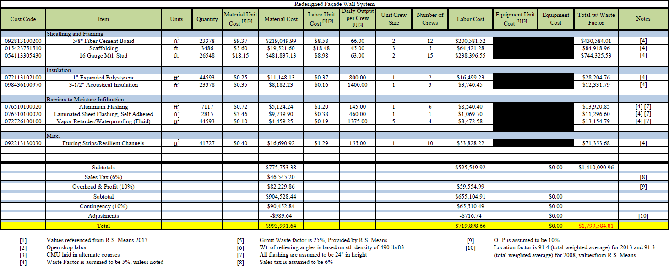
Building Overview Scope and Intent Solving Torsional Irregularity Construction Management Lessons Learned

Slide 22
Table P1.12, Thermal and Moisture Resistance of Retrofit and Original
Wall System | Total R-Value (h-ft²-°F/Btu) | Total R_{v}-Value
Original | 1.2 | 88.9
Retrofit | 6.2 | 114.2
Table P1.15, Average Relative Humidity Across Retrofit Wall Assembly
Layer Inter-face | R_{i}/R | R_{vi}/R_{v} | Normal Conditions (%) |  |  |  | 100% Exterior RH (%)
 |  |  | Winter |  | Summer |  | Winter |  | Summer
 |  |  | High | Low | High | Low | High | Low | High | Low
1 |  |  | 59.0 | 86.0 | 75.0 | 90.0 | 100.0 | 100.0 | 100.0 | 100.0
2 | 0.016 | 0.034 | 58.8 | 86.0 | 74.1 | 88.7 | 98.3 | 99.3 | 98.5 | 98.3
3 | 0.710 | 0.222 | 54.4 | 48.9 | 98.3 | 77.9 | 83.0 | 54.2 | 127.6 | 85.1
4 | 0.098 | 0.000 | 53.9 | 44.9 | 104.8 | 77.6 | 82.3 | 49.7 | 135.9 | 84.8
5 | 0.000 | 0.000 | 53.9 | 44.9 | 104.8 | 77.6 | 82.3 | 49.7 | 135.9 | 84.8
6 | 0.085 | 0.741 | 50.4 | 54.0 | 47.3 | 50.3 | 50.5 | 54.1 | 47.4 | 50.3
7 | 0.000 | 0.000 | 50.4 | 54.0 | 47.3 | 50.3 | 50.5 | 54.0 | 47.4 | 50.3
8 | 0.091 | 0.003 | 50.0 | 50.0 | 50.0 | 50.0 | 50.0 | 50.0 | 50.0 | 50.0
Table P1.13, Average Relative Humidity Across Retrofit Wall Assembly
Layer Inter-face | R_{i}/R | R_{vi}/R_{v} | Normal Conditions (%) |  |  |  | 100% Exterior RH (%)
 |  |  | Winter |  | Summer |  | Winter |  | Summer
 |  |  | High | Low | High | Low | High | Low | High | Low
1 |  |  | 59.0 | 86.0 | 75.0 | 90.0 | 100.0 | 100.0 | 100.0 | 100.0
2 | 0.235 | 0.892 | 53.9 | 95.9 | 36.7 | 55.7 | 58.2 | 97.1 | 39.8 | 56.7
3 | 0.042 | 0.000 | 53.7 | 92.2 | 37.7 | 55.6 | 58.0 | 93.3 | 40.9 | 56.6
4 | 0.000 | 0.018 | 53.6 | 92.7 | 36.6 | 54.9 | 57.2 | 93.7 | 39.3 | 55.8
5 | 0.011 | 0.078 | 53.2 | 94.0 | 32.4 | 52.0 | 53.7 | 94.1 | 32.8 | 52.1
6 | 0.709 | 0.000 | 50.1 | 49.9 | 51.0 | 50.5 | 50.5 | 50.0 | 51.6 | 50.6
7 | 0.003 | 0.012 | 50.0 | 50.0 | 50.0 | 50.0 | 50.0 | 50.0 | 50.0 | 50.0
Table P1.14, Average Relative Humidity Across Original Wall Assembly
Layer Inter-face | R_{i}/R | R_{vi}/R_{v} | Normal Conditions (%) |  |  |  | 100% Exterior RH (%)
 |  |  | Winter |  | Summer |  | Winter |  | Summer
 |  |  | High | Low | High | Low | High | Low | High | Low
1 |  |  | 59.0 | 86.0 | 75.0 | 90.0 | 100.0 | 100.0 | 100.0 | 100.0
2 | 0.082 | 0.043 | 58.4 | 81.0 | 76.6 | 88.1 | 97.3 | 93.3 | 101.7 | 97.6
3 | 0.000 | 0.000 | 58.4 | 81.0 | 76.6 | 88.1 | 97.3 | 93.3 | 101.7 | 97.6
4 | 0.000 | 0.000 | 58.4 | 81.0 | 76.6 | 88.0 | 97.3 | 93.4 | 101.7 | 97.6
5 | 0.442 | 0.953 | 52.1 | 75.9 | 36.9 | 51.1 | 52.2 | 75.9 | 37.1 | 51.2
6 | 0.002 | 0.000 | 52.1 | 75.7 | 37.0 | 51.1 | 52.2 | 75.8 | 37.1 | 51.2
7 | 0.474 | 0.004 | 50.0 | 50.0 | 50.0 | 50.0 | 50.0 | 50.0 | 50.0 | 50.0
Building Overview Scope and Intent Solving Torsional Irregularity Construction Management Lessons Learned

